Slide 1
Comparison of QMC and experimental correlation functions

Slide 2
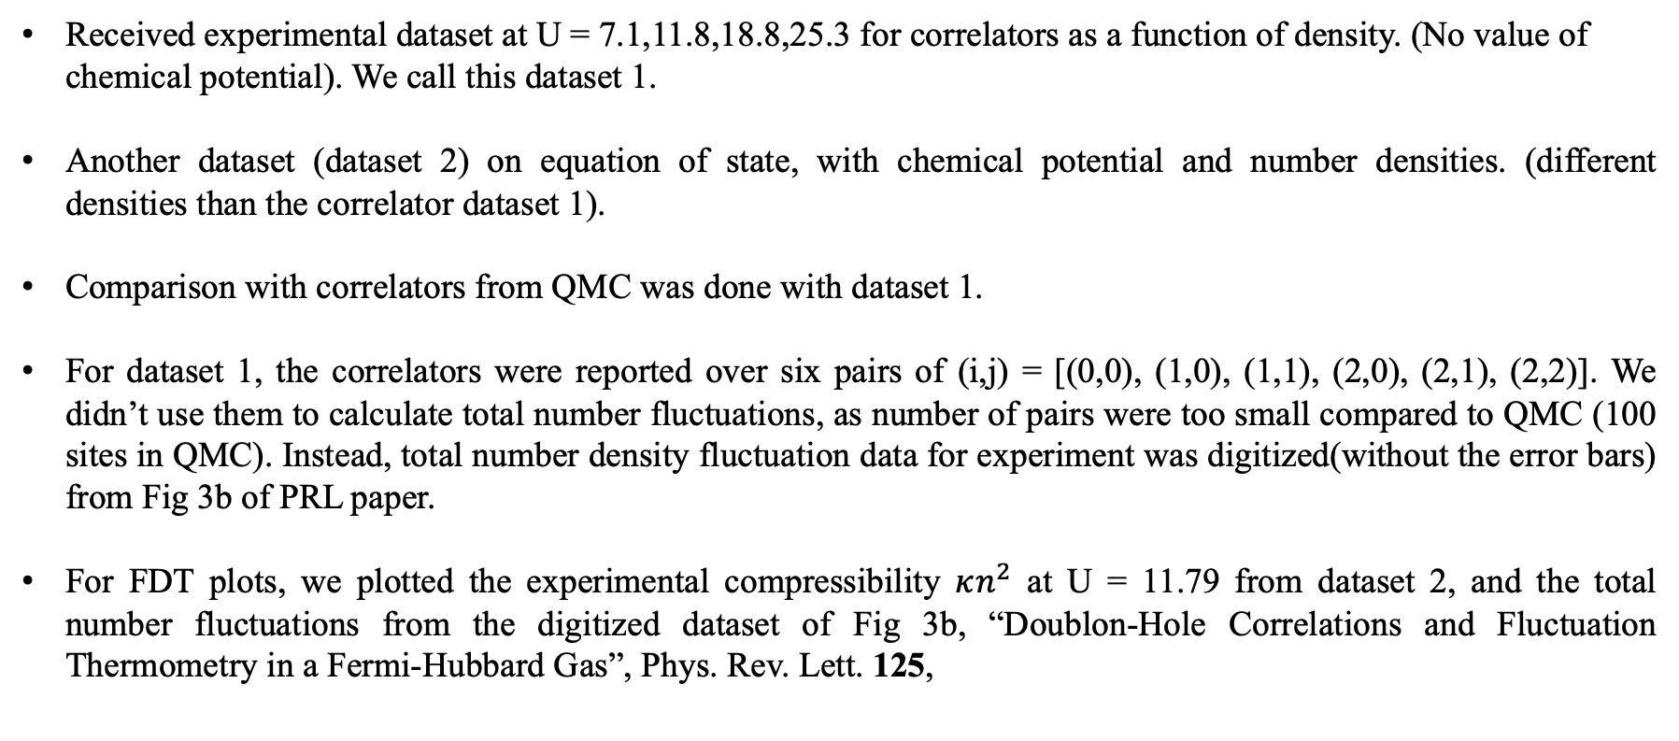
Brief comments
Received experimental dataset at U = 7.1,11.8,18.8,25.3 for correlators as a function of density. (No value of
chemical potential). We call this dataset 1.
Another dataset (dataset 2) on equation of state, with chemical potential and number densities. (different densities than the correlator dataset 1).
Comparison with correlators from QMC was done with dataset 1.
For dataset 1, the correlators were reported over six pairs of (i,j) = [(0,0), (1,0), (1,1), (2,0), (2,1), (2,2)]. We didn’t use them to calculate total number fluctuations, as number of pairs were too small compared to QMC (100 sites in QMC). Instead, total number density fluctuation data for experiment was digitized(without the error bars) from Fig 3b of PRL paper.
For FDT plots, we plotted the experimental compressibility $κn^{2}$ at U = 11.79 from dataset 2, and the total number fluctuations from the digitized dataset of Fig 3b, “Doublon-Hole Correlations and Fluctuation Thermometry in a Fermi-Hubbard Gas”, Phys. Rev. Lett. 125,

Slide 3
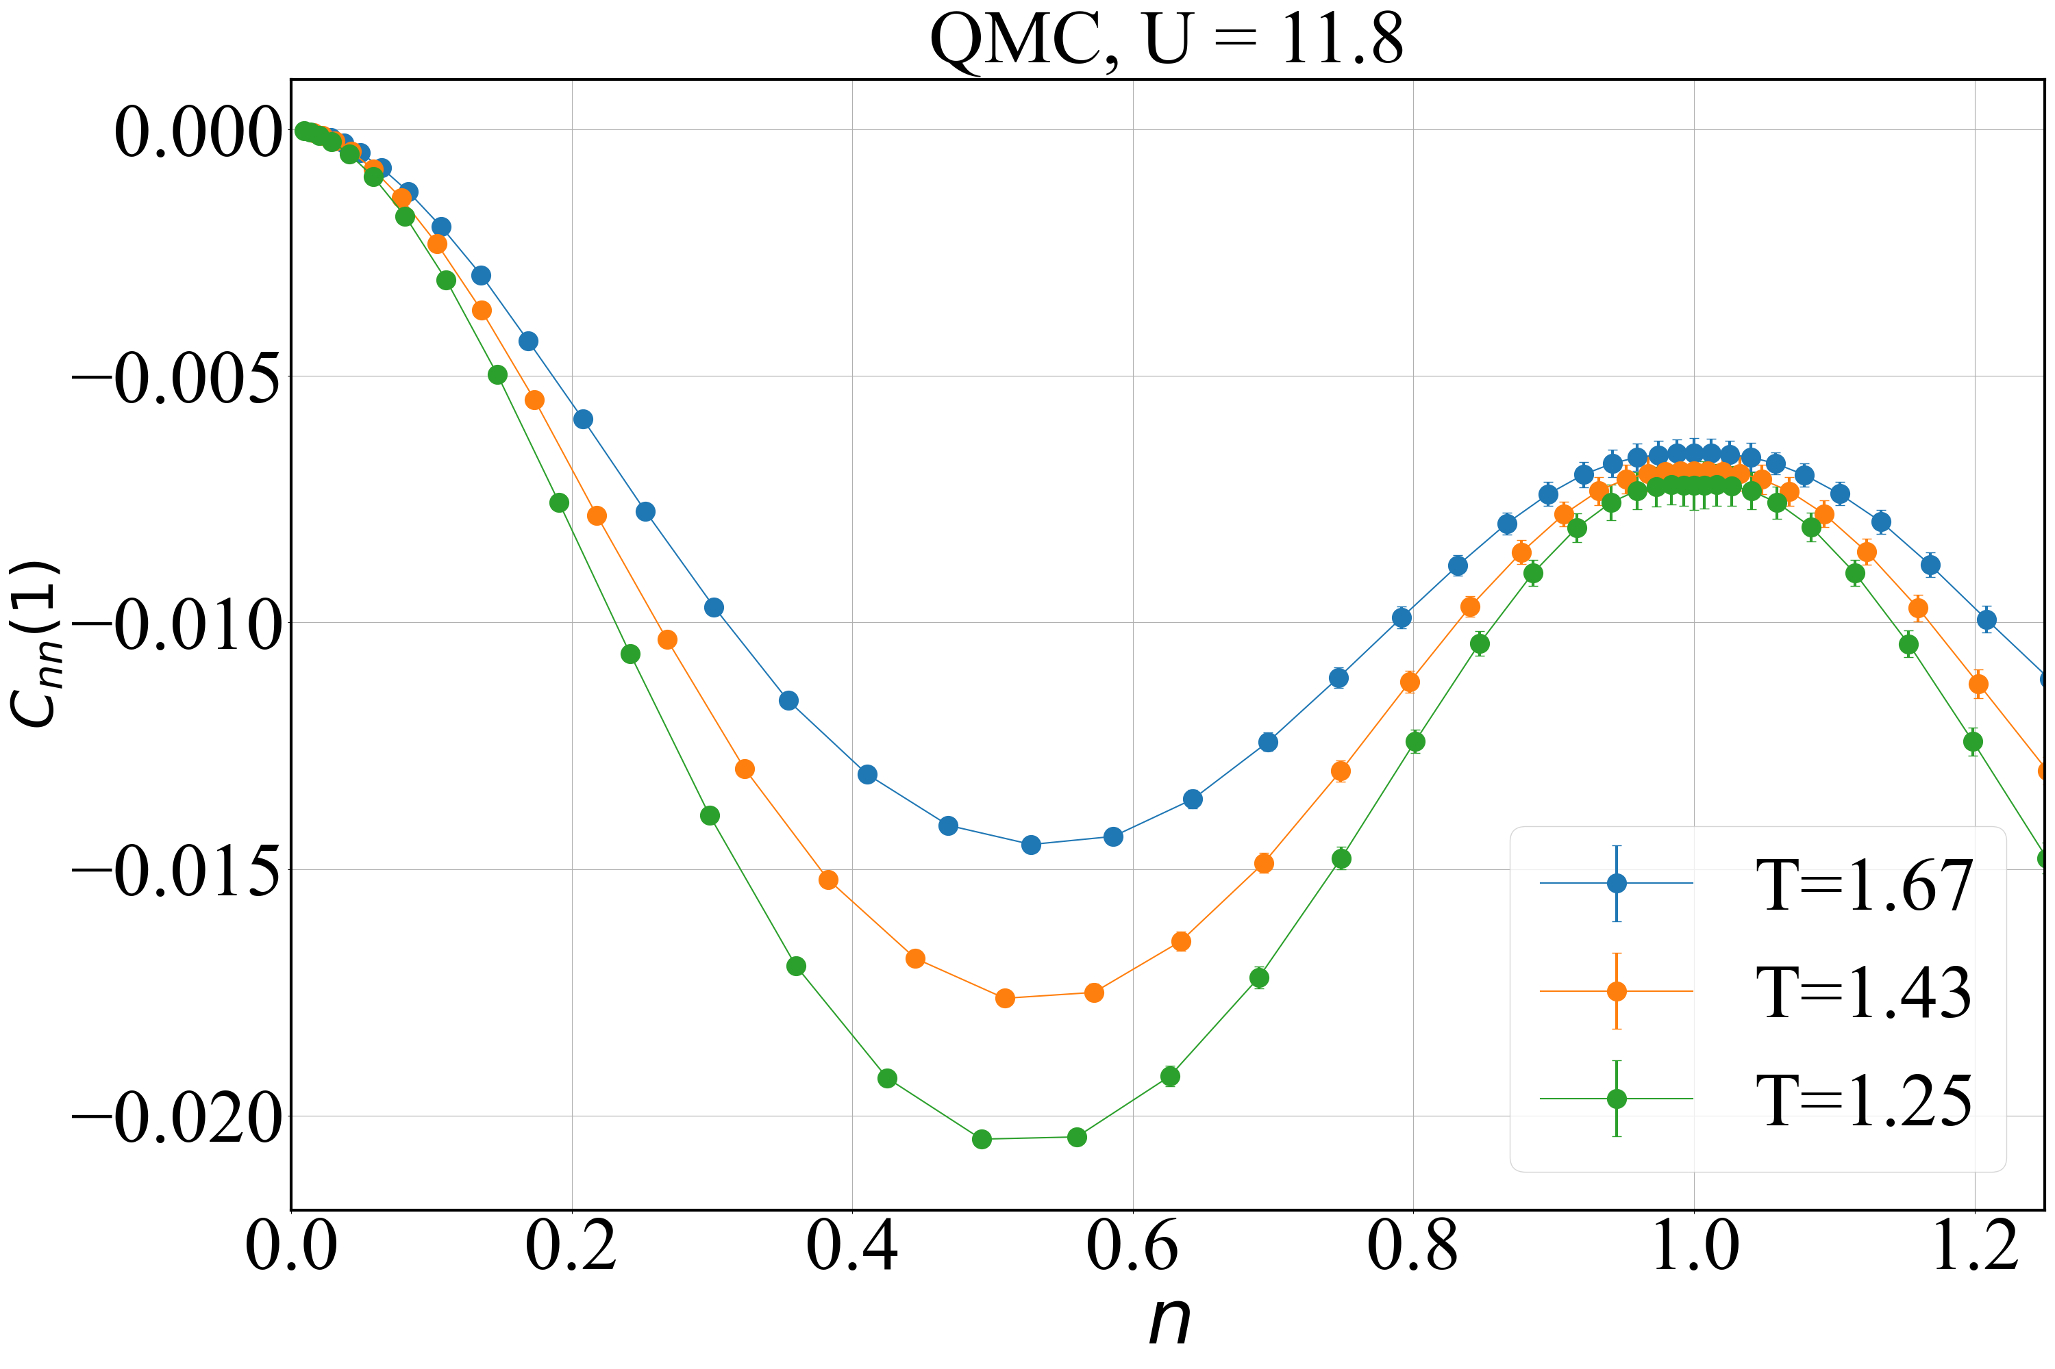
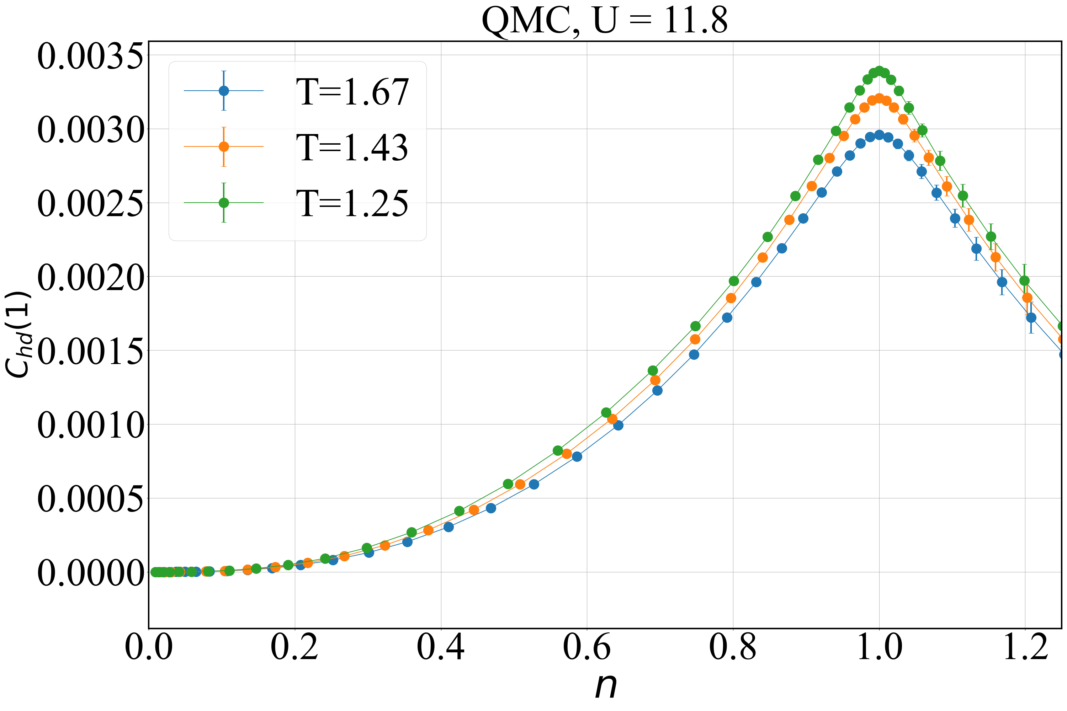
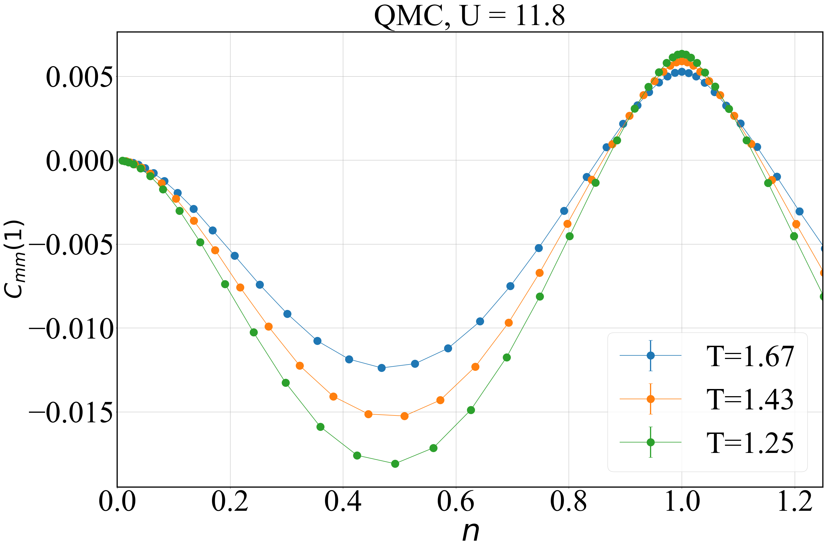
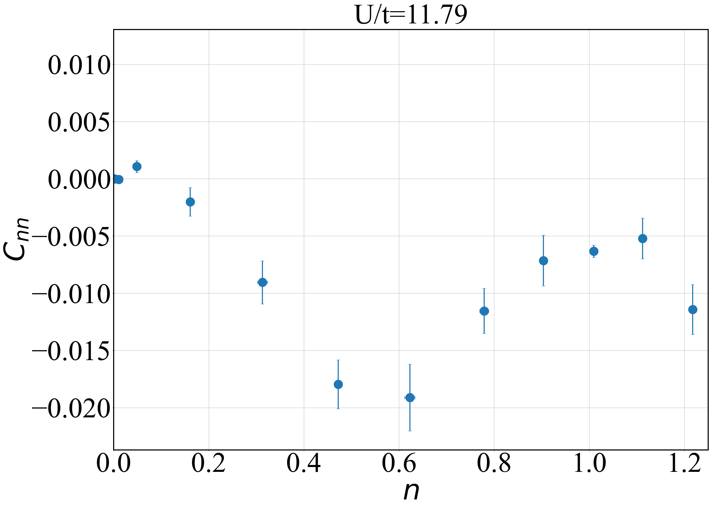
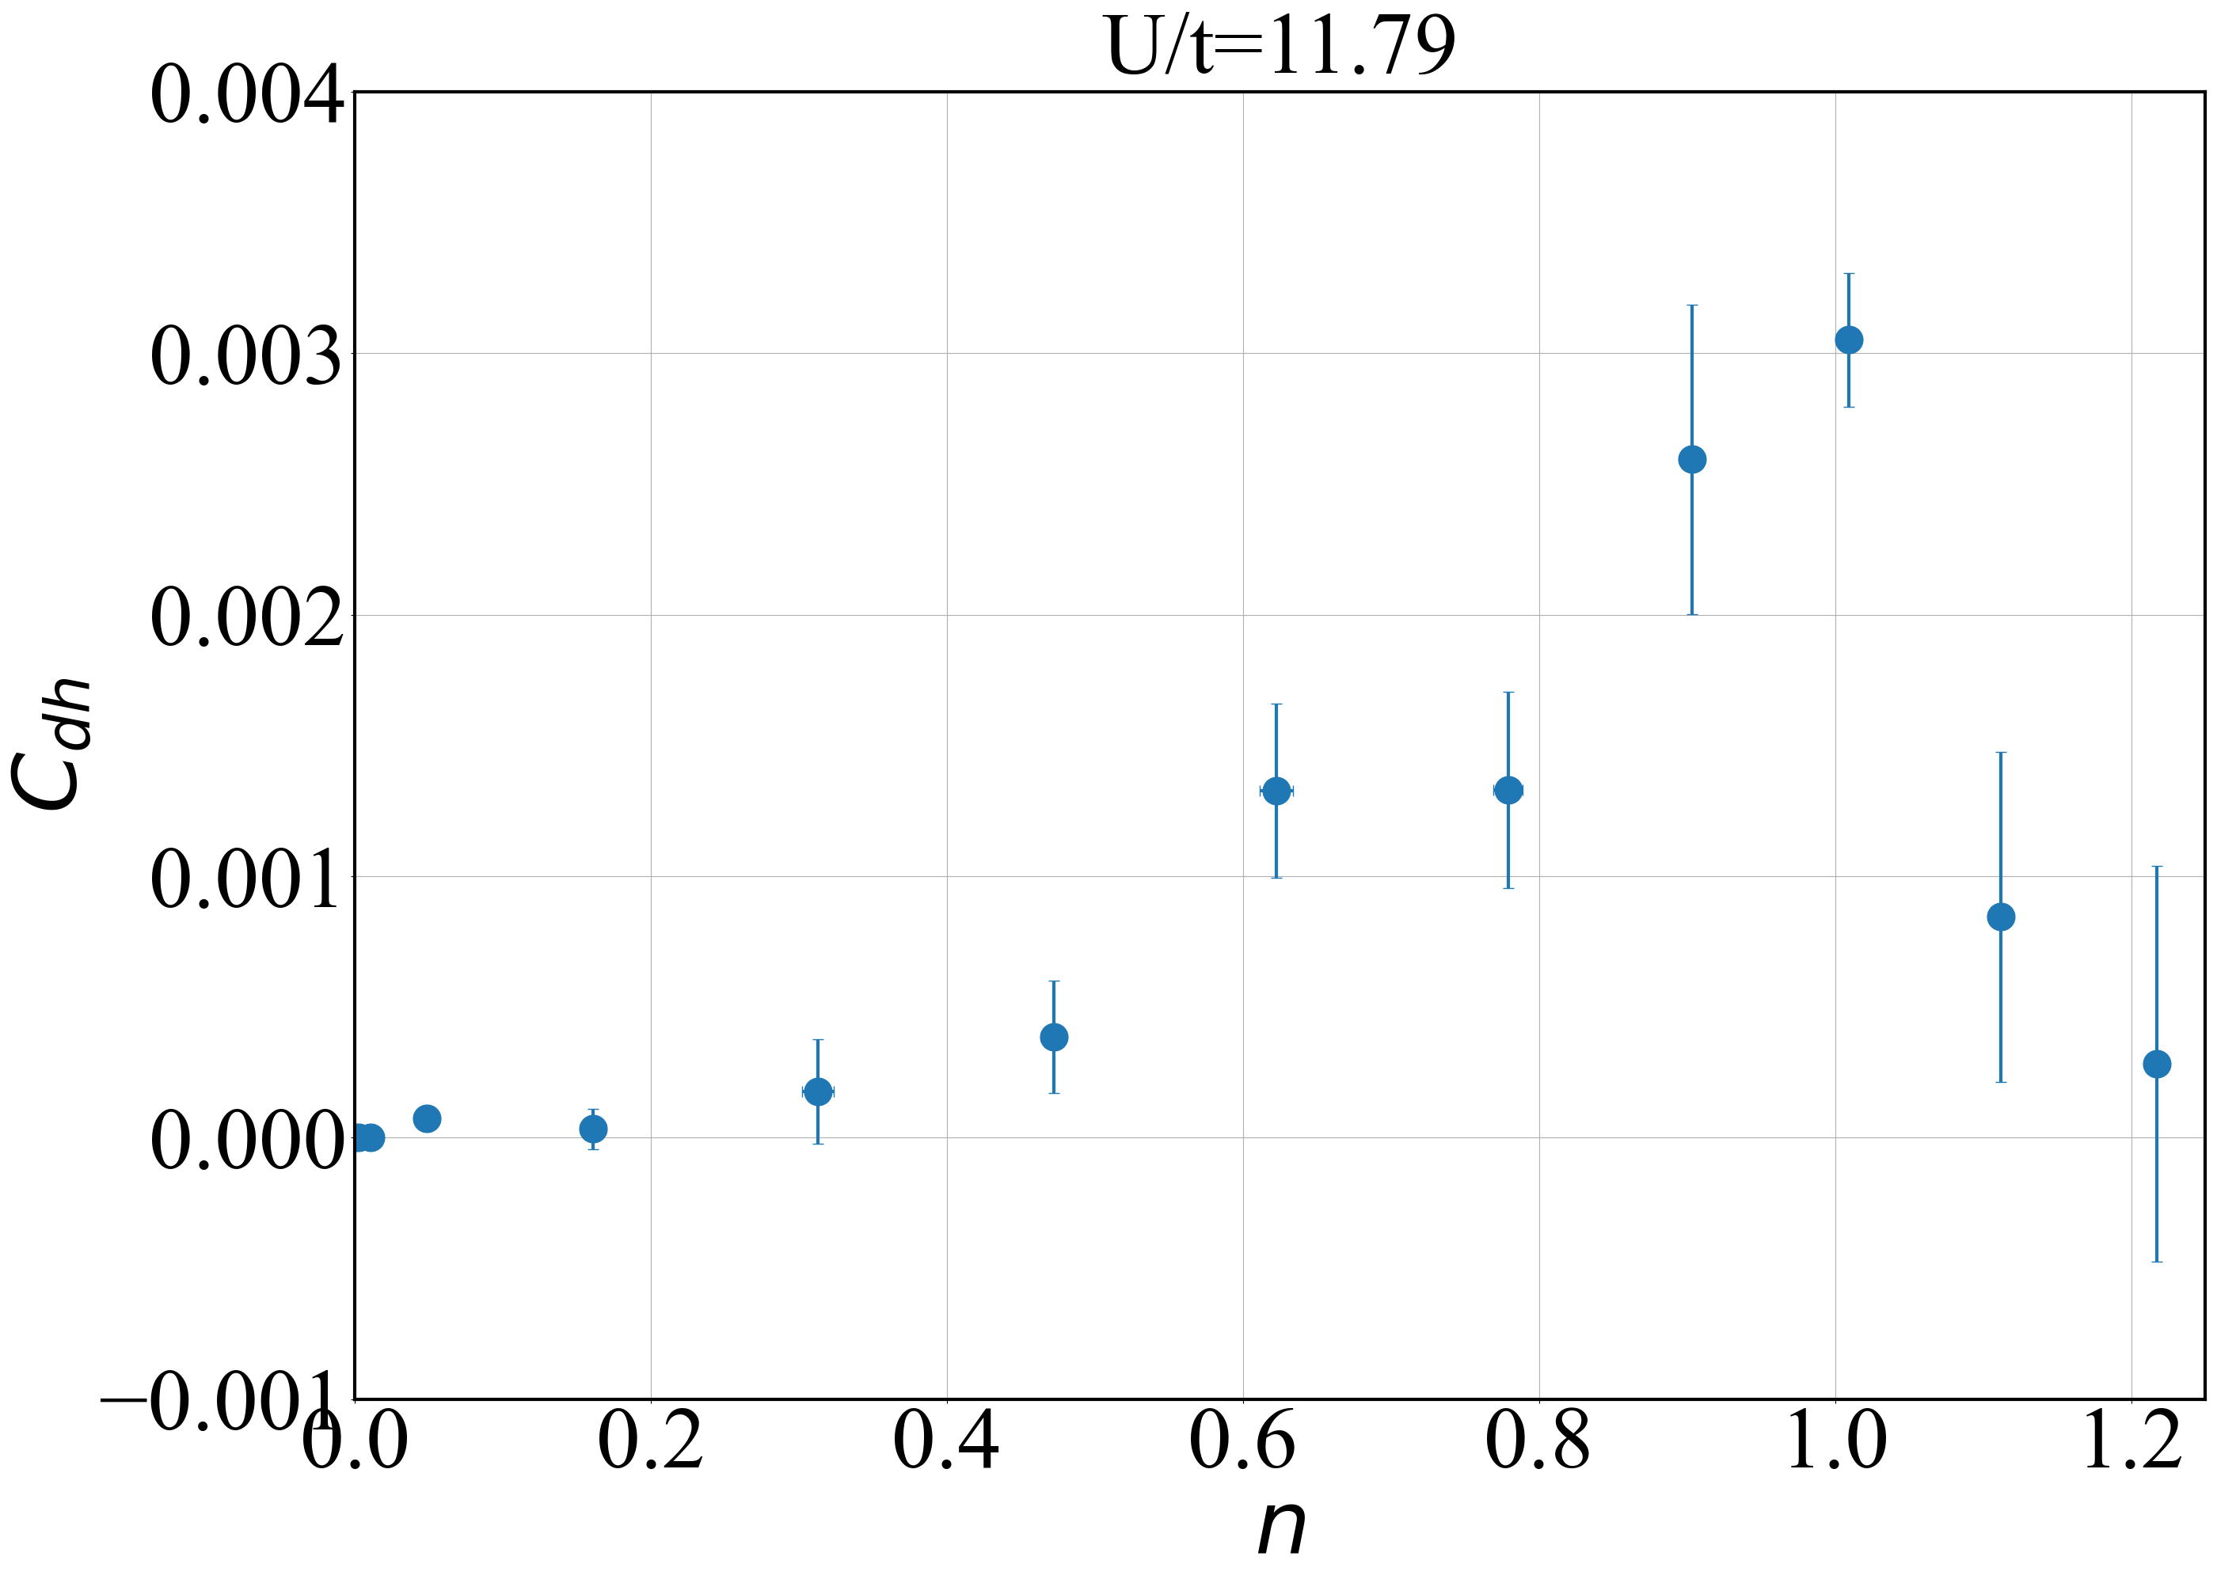
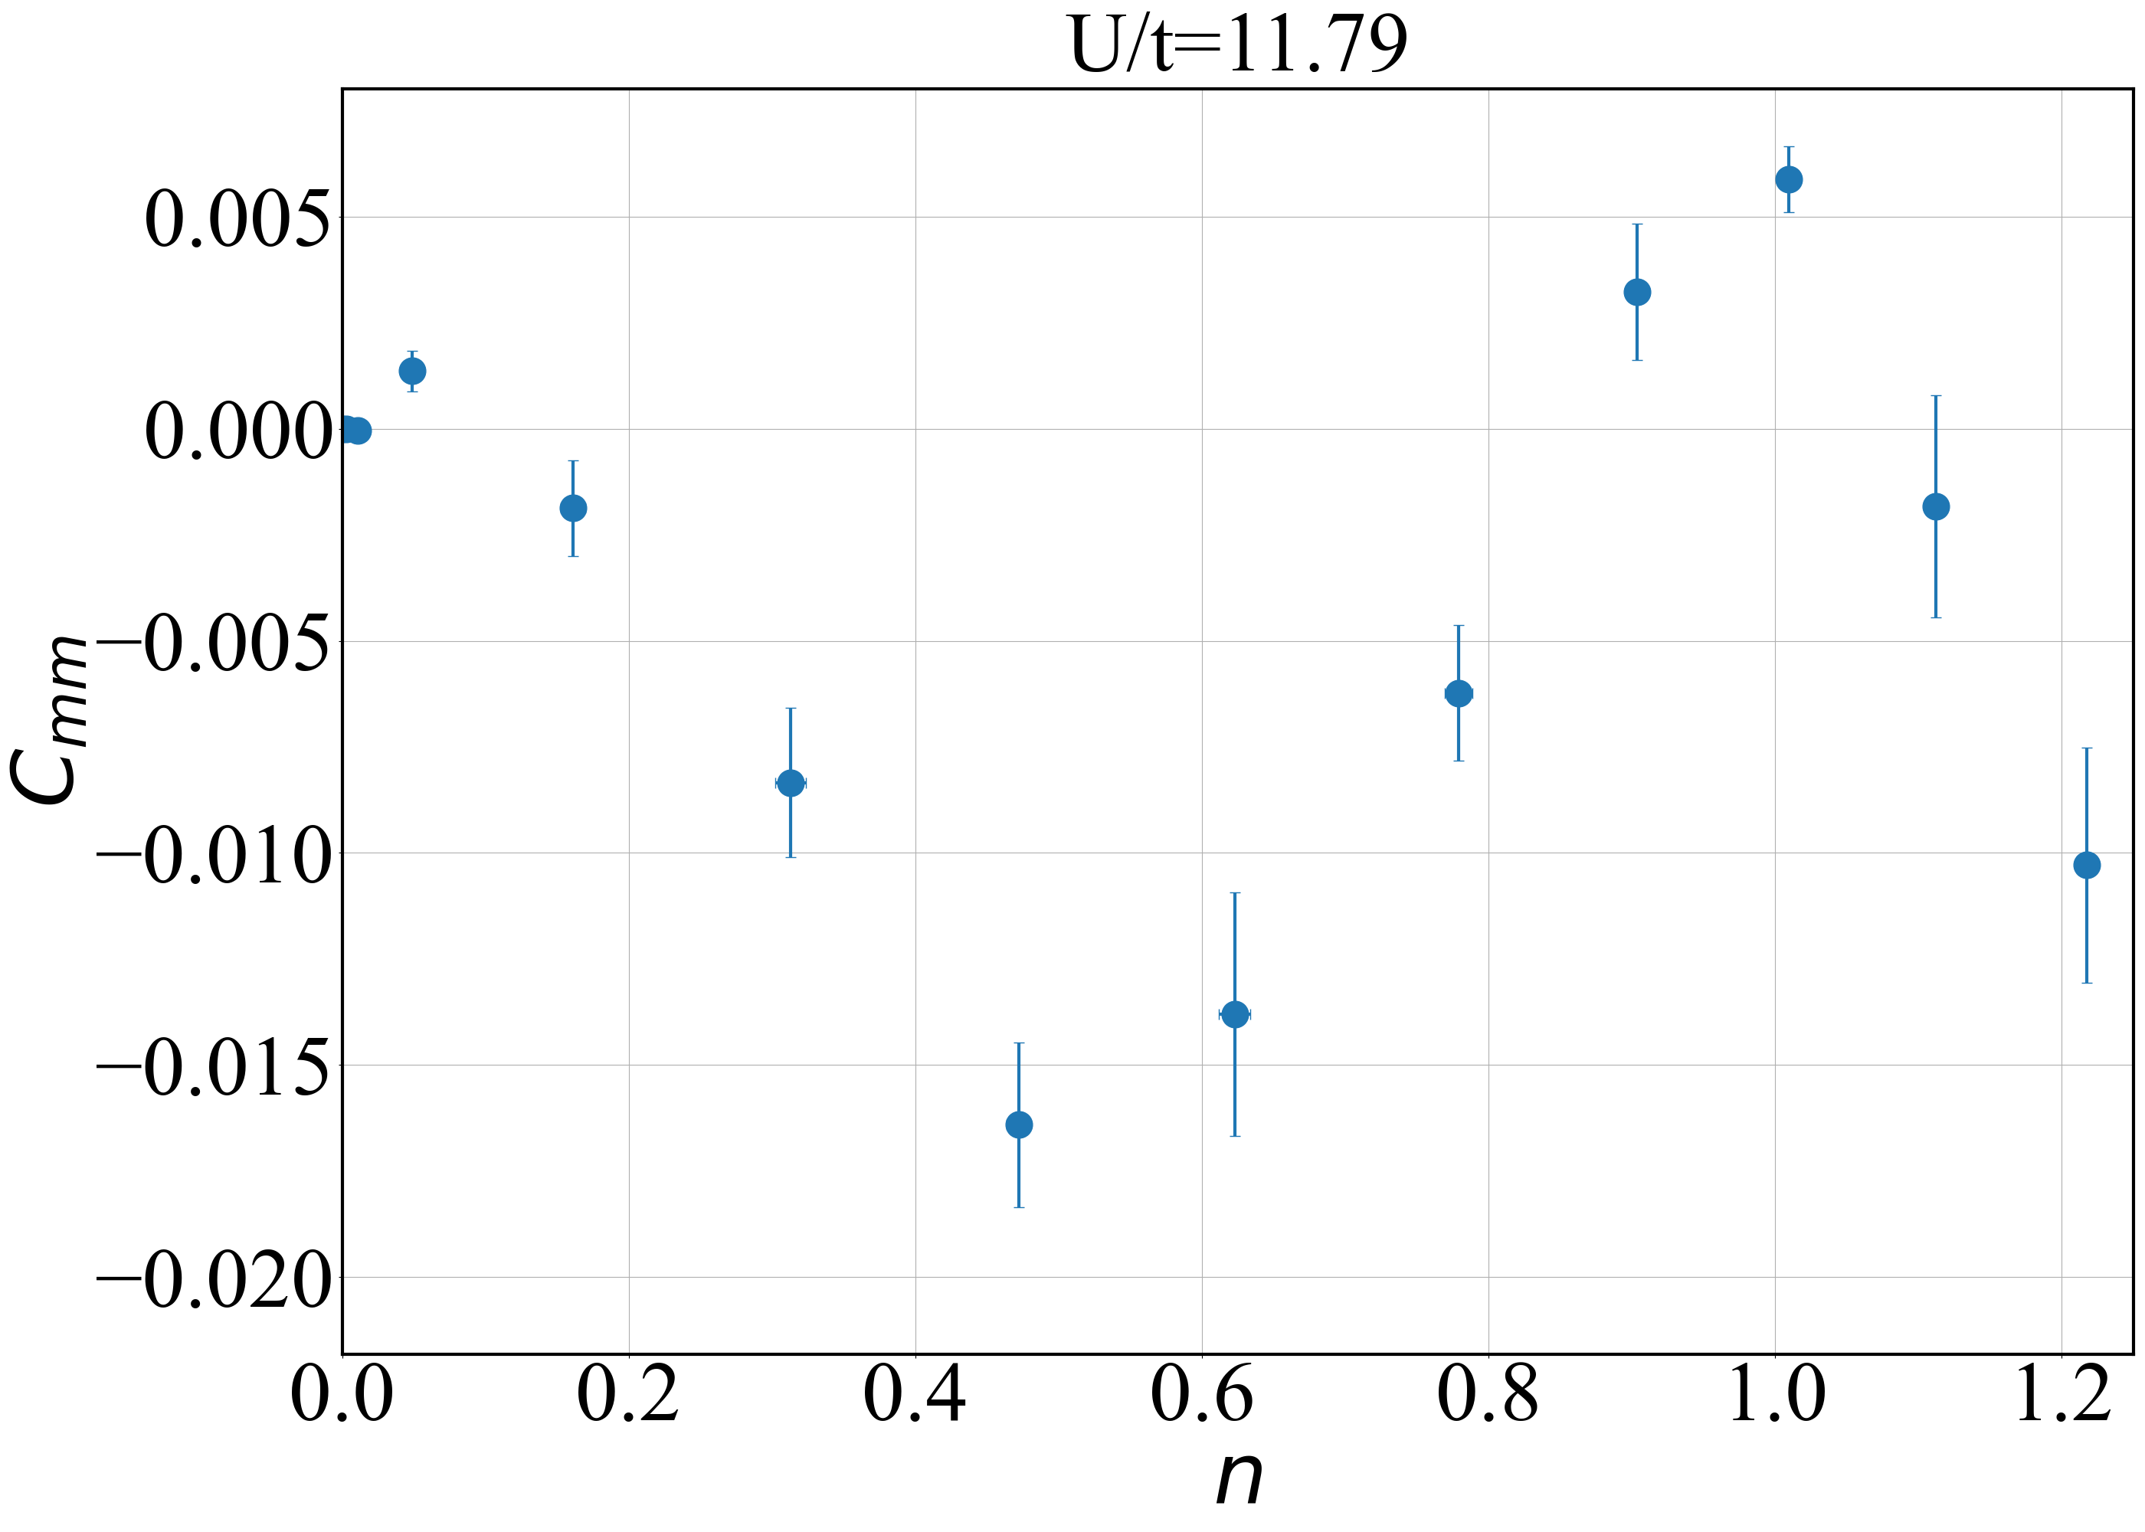
Nearest neighbor correlators at U = 11.8
QMC
Experiment
Note: Correlators from DQMC agree with experiment the most at T = 1.43

Slide 4
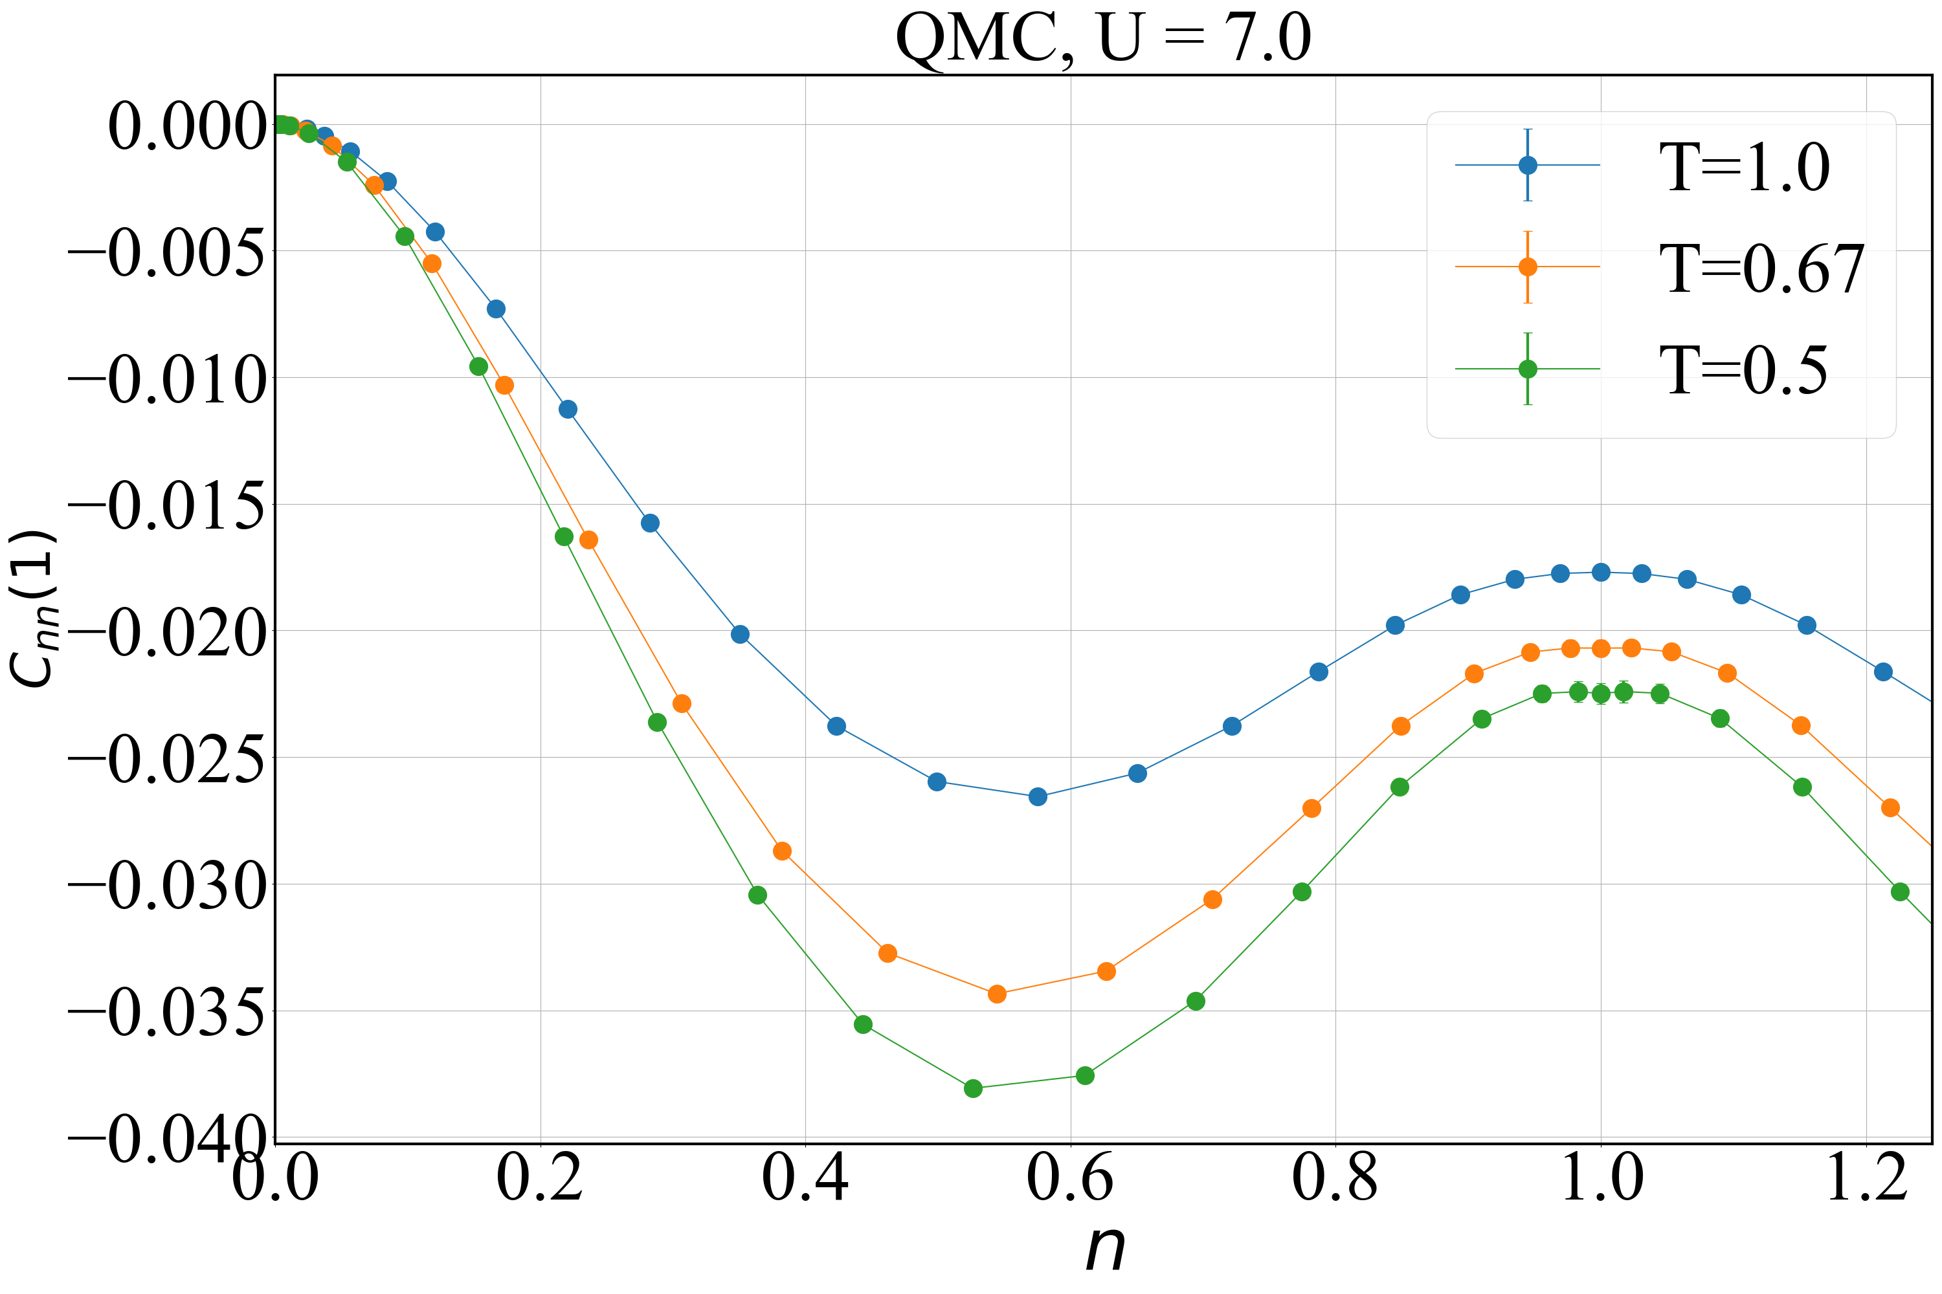
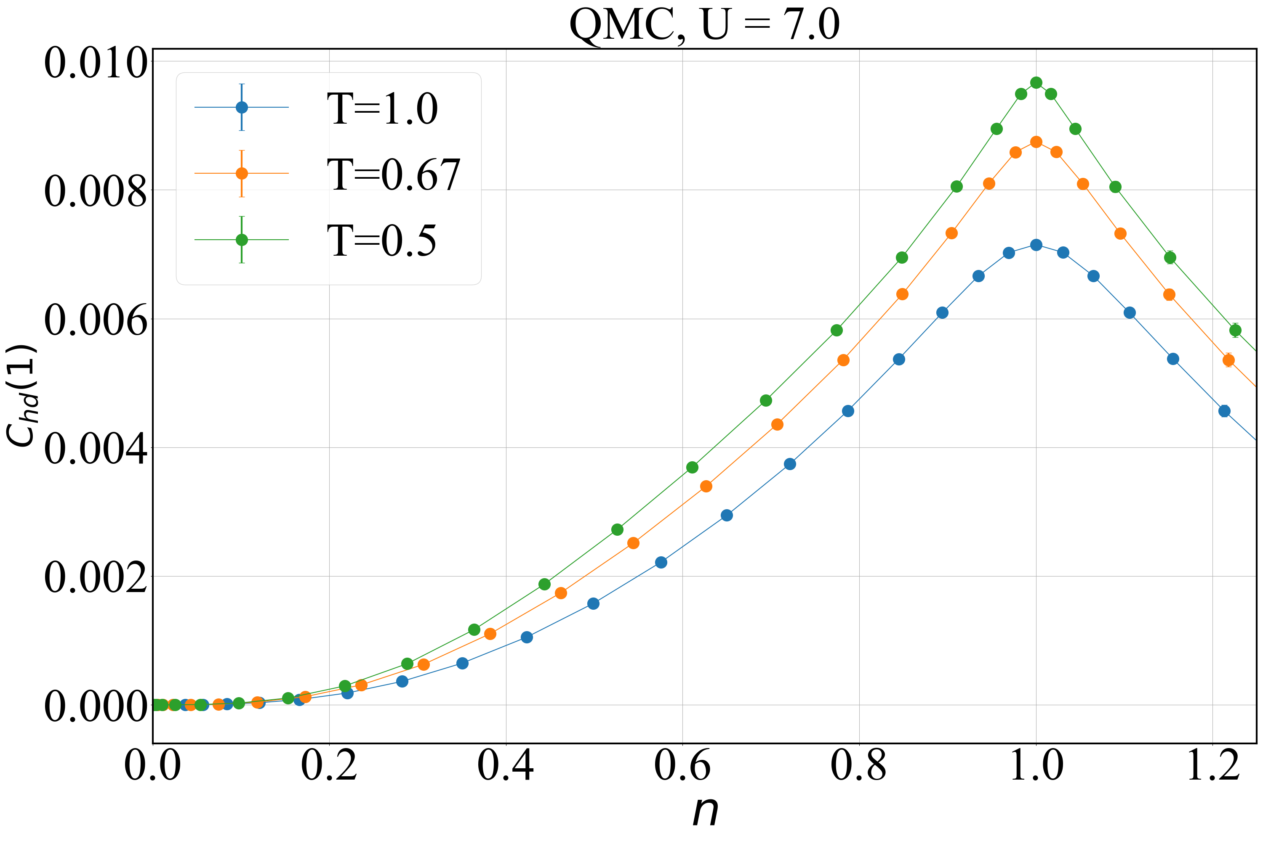
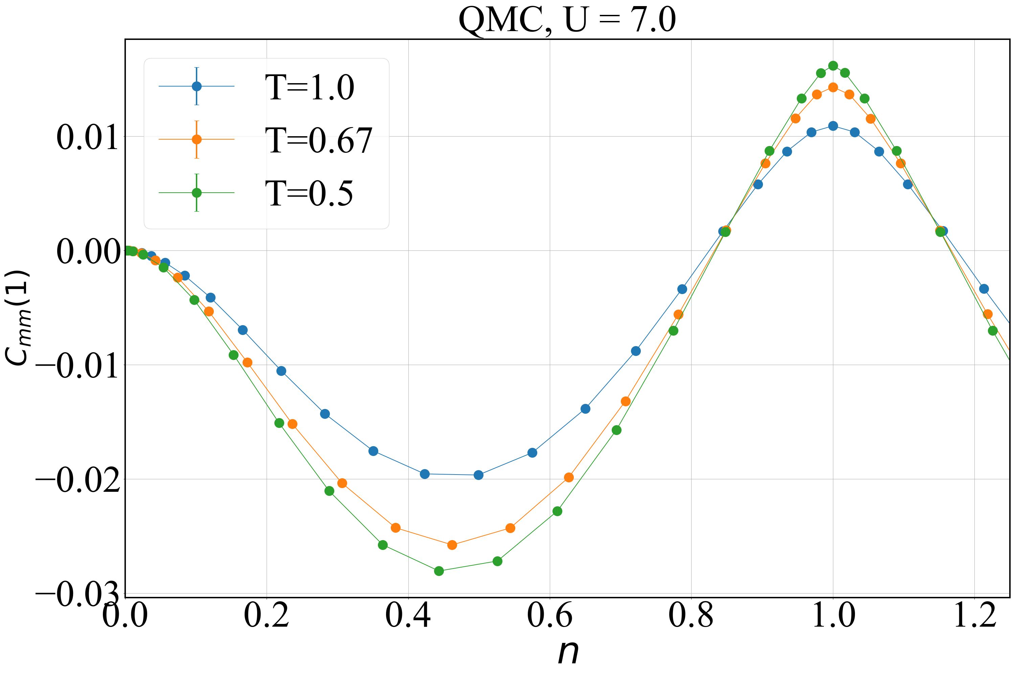
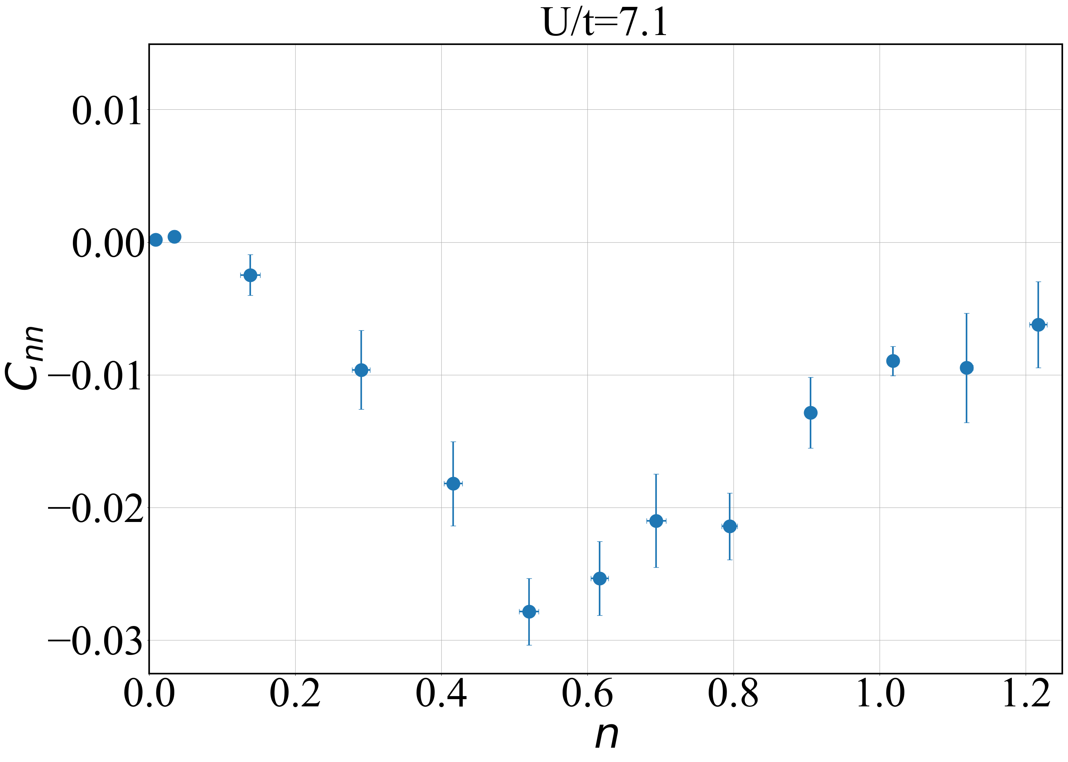
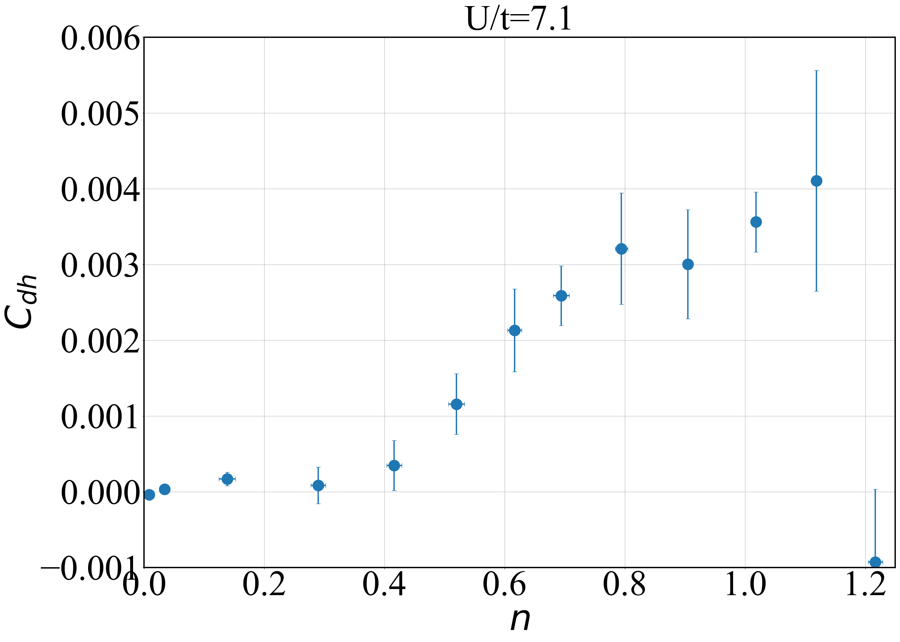
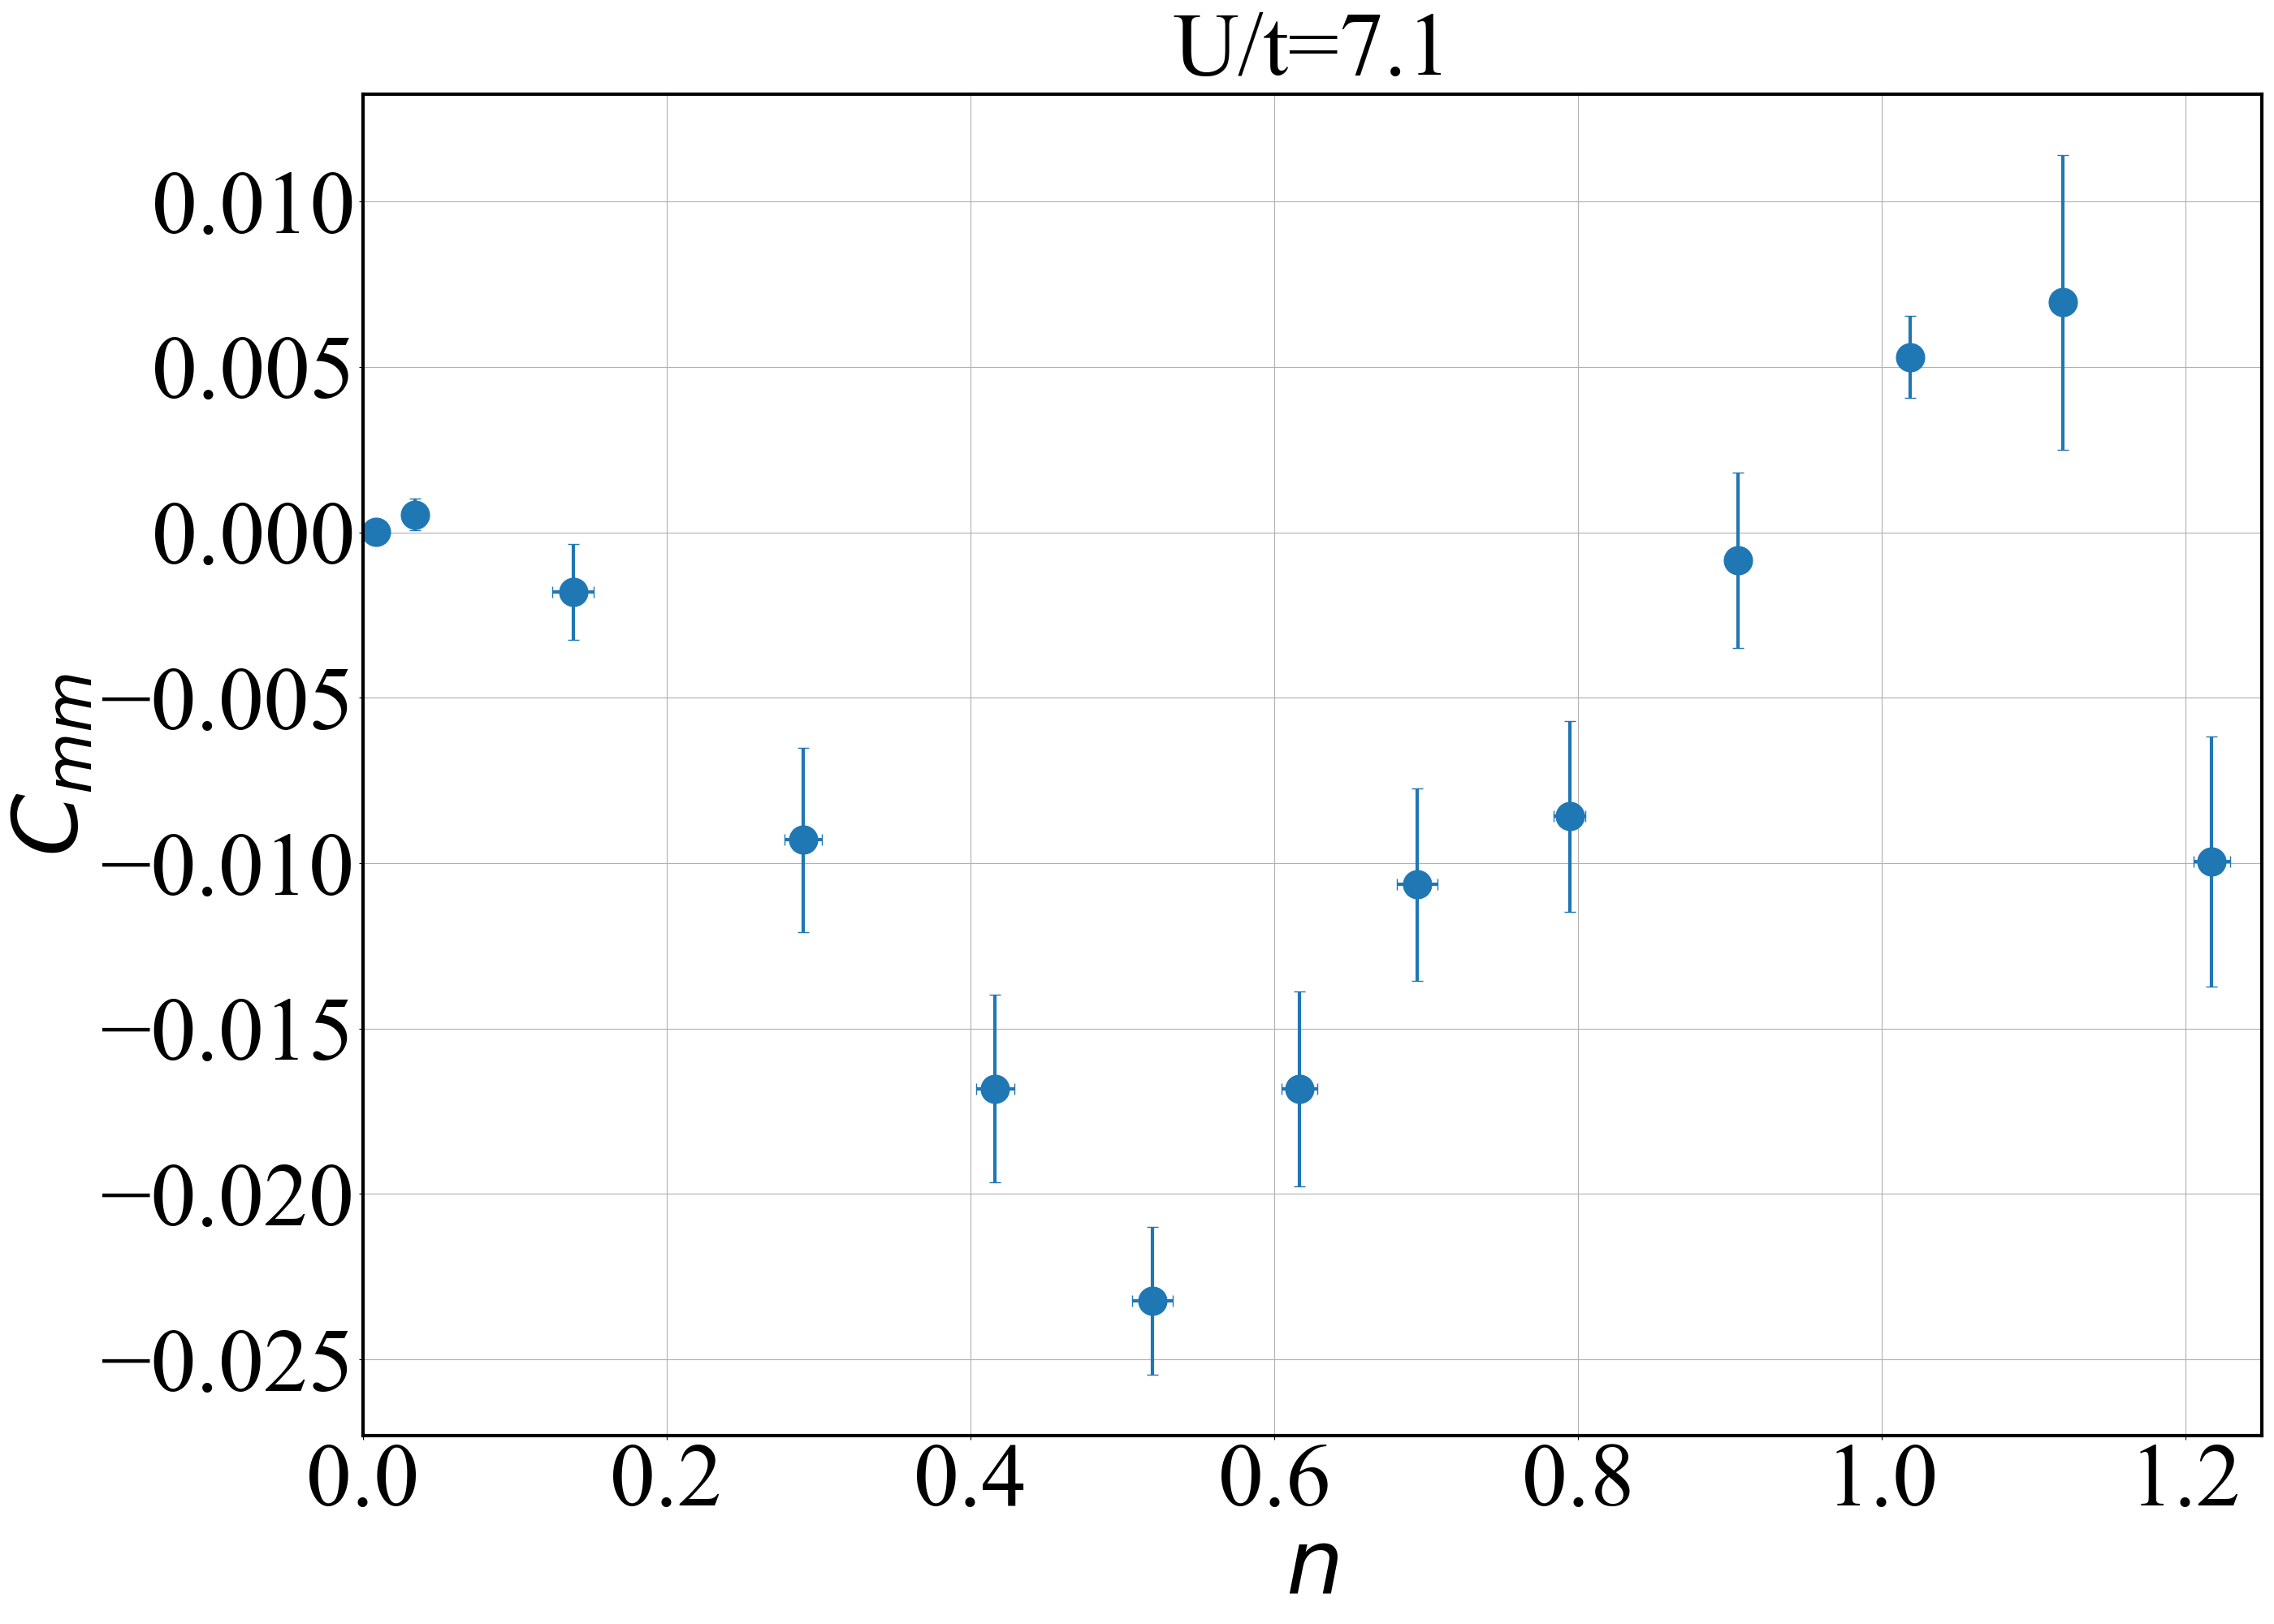
Nearest neighbor correlators at U = 7.0
QMC
Experiment
Note: Correlators from DQMC agree with experiment the most at T = 0.67

Slide 5
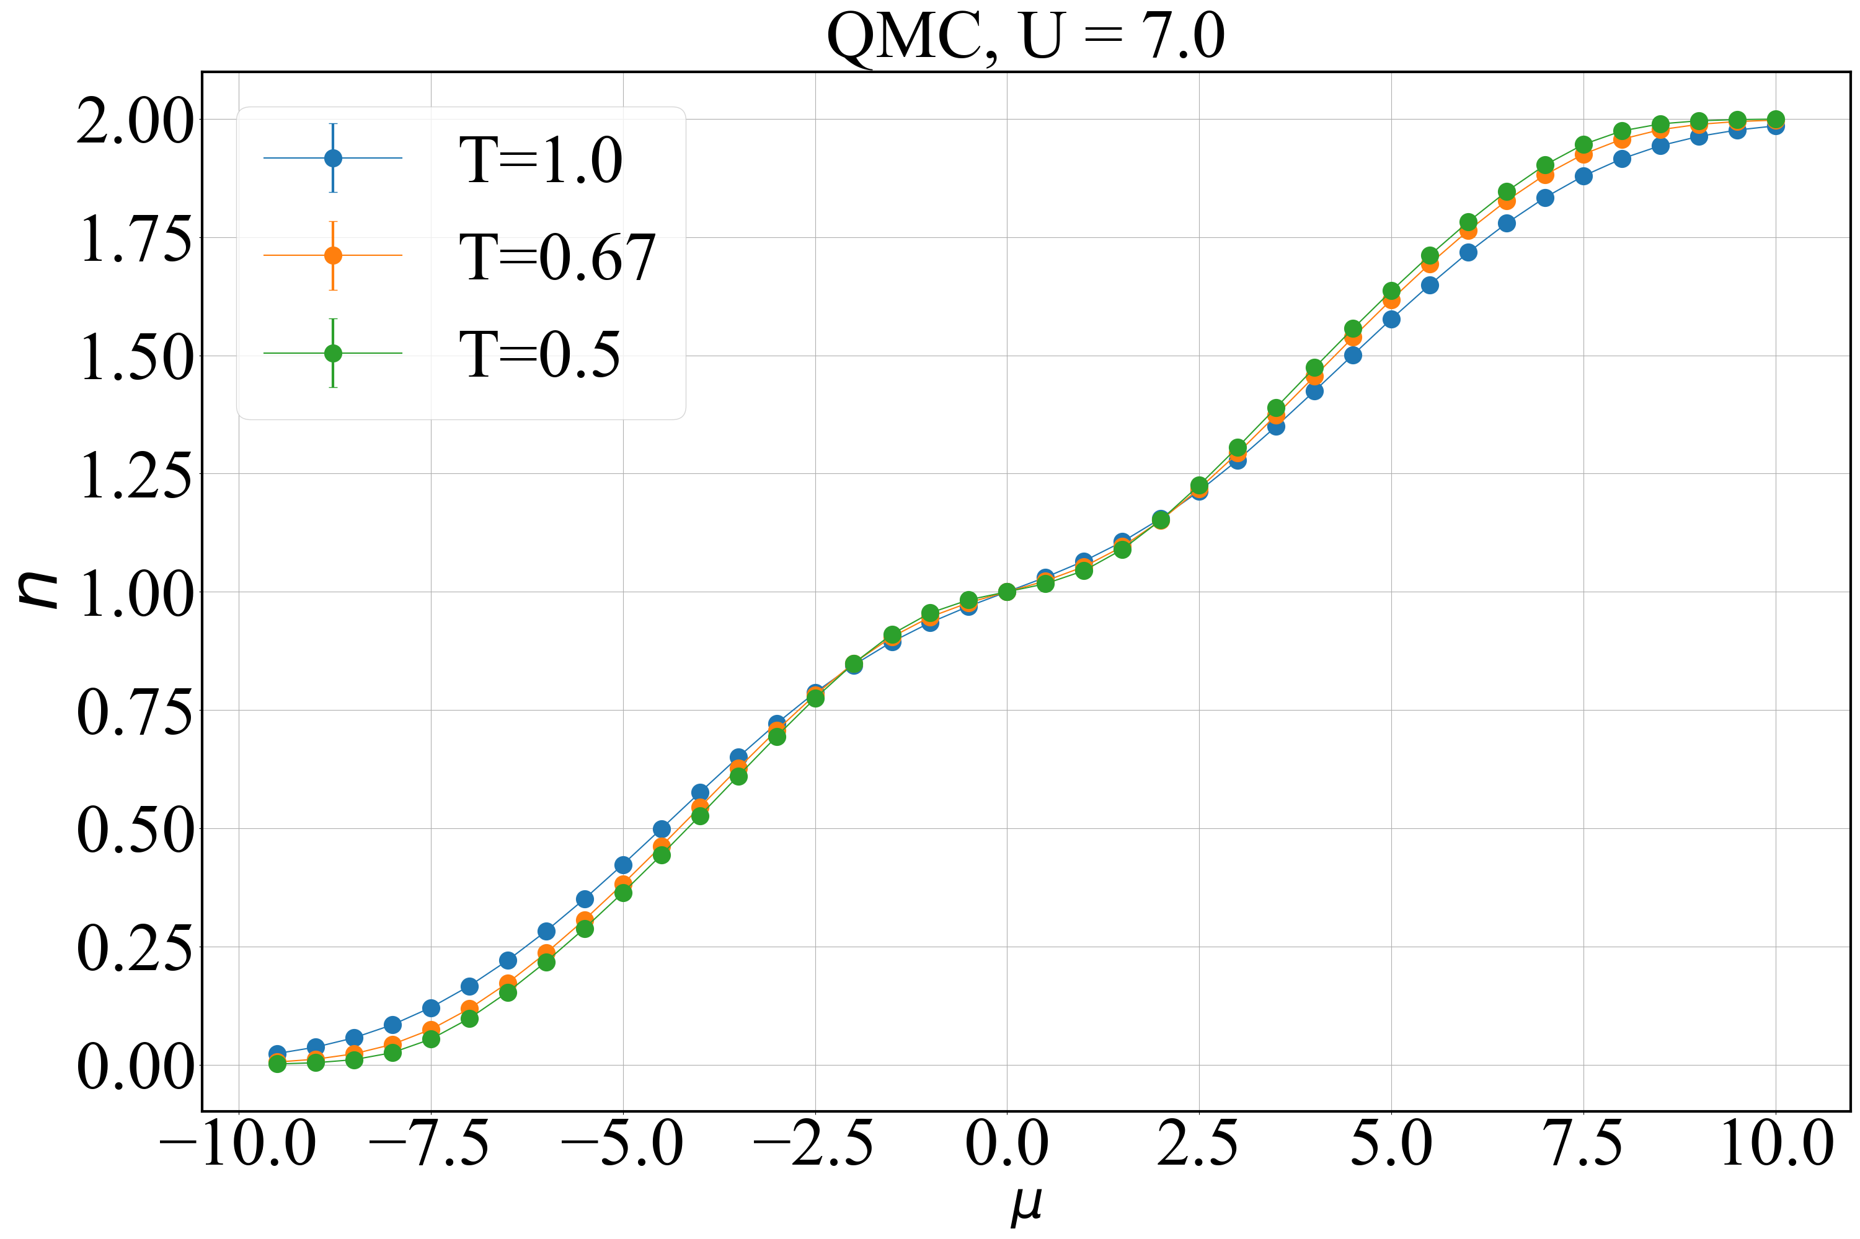
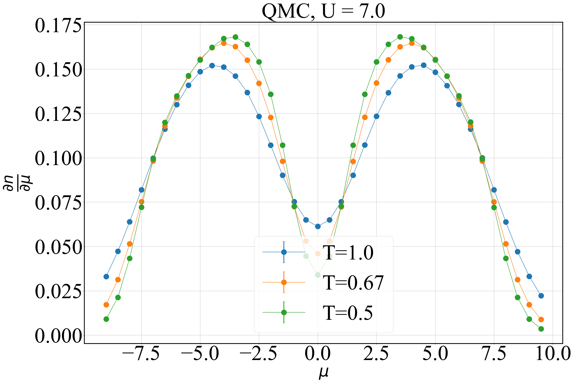
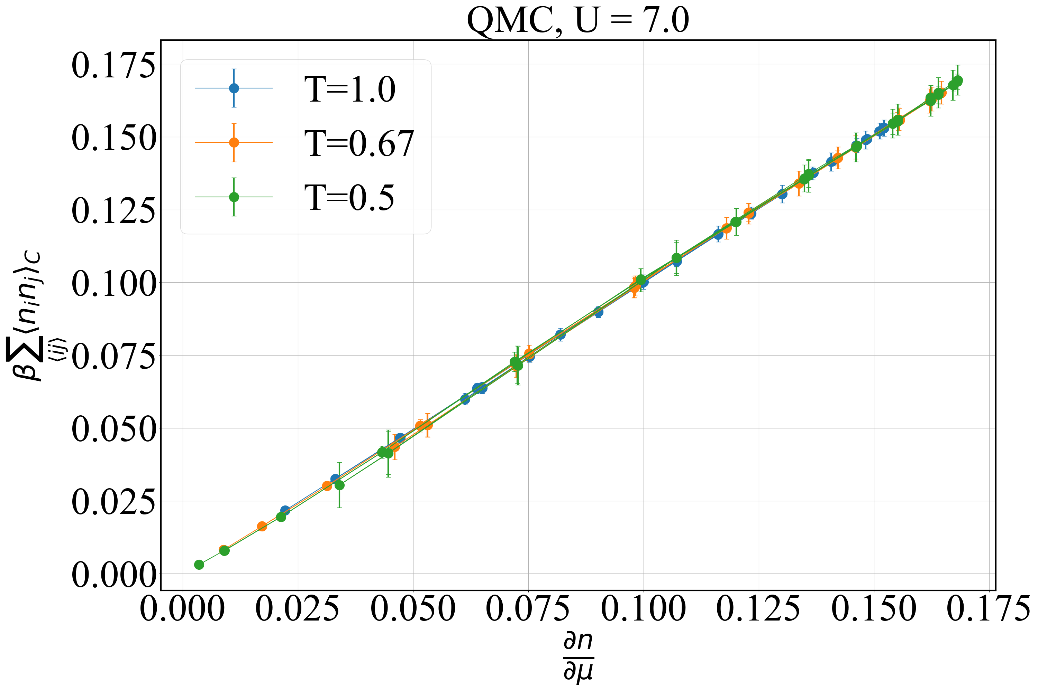
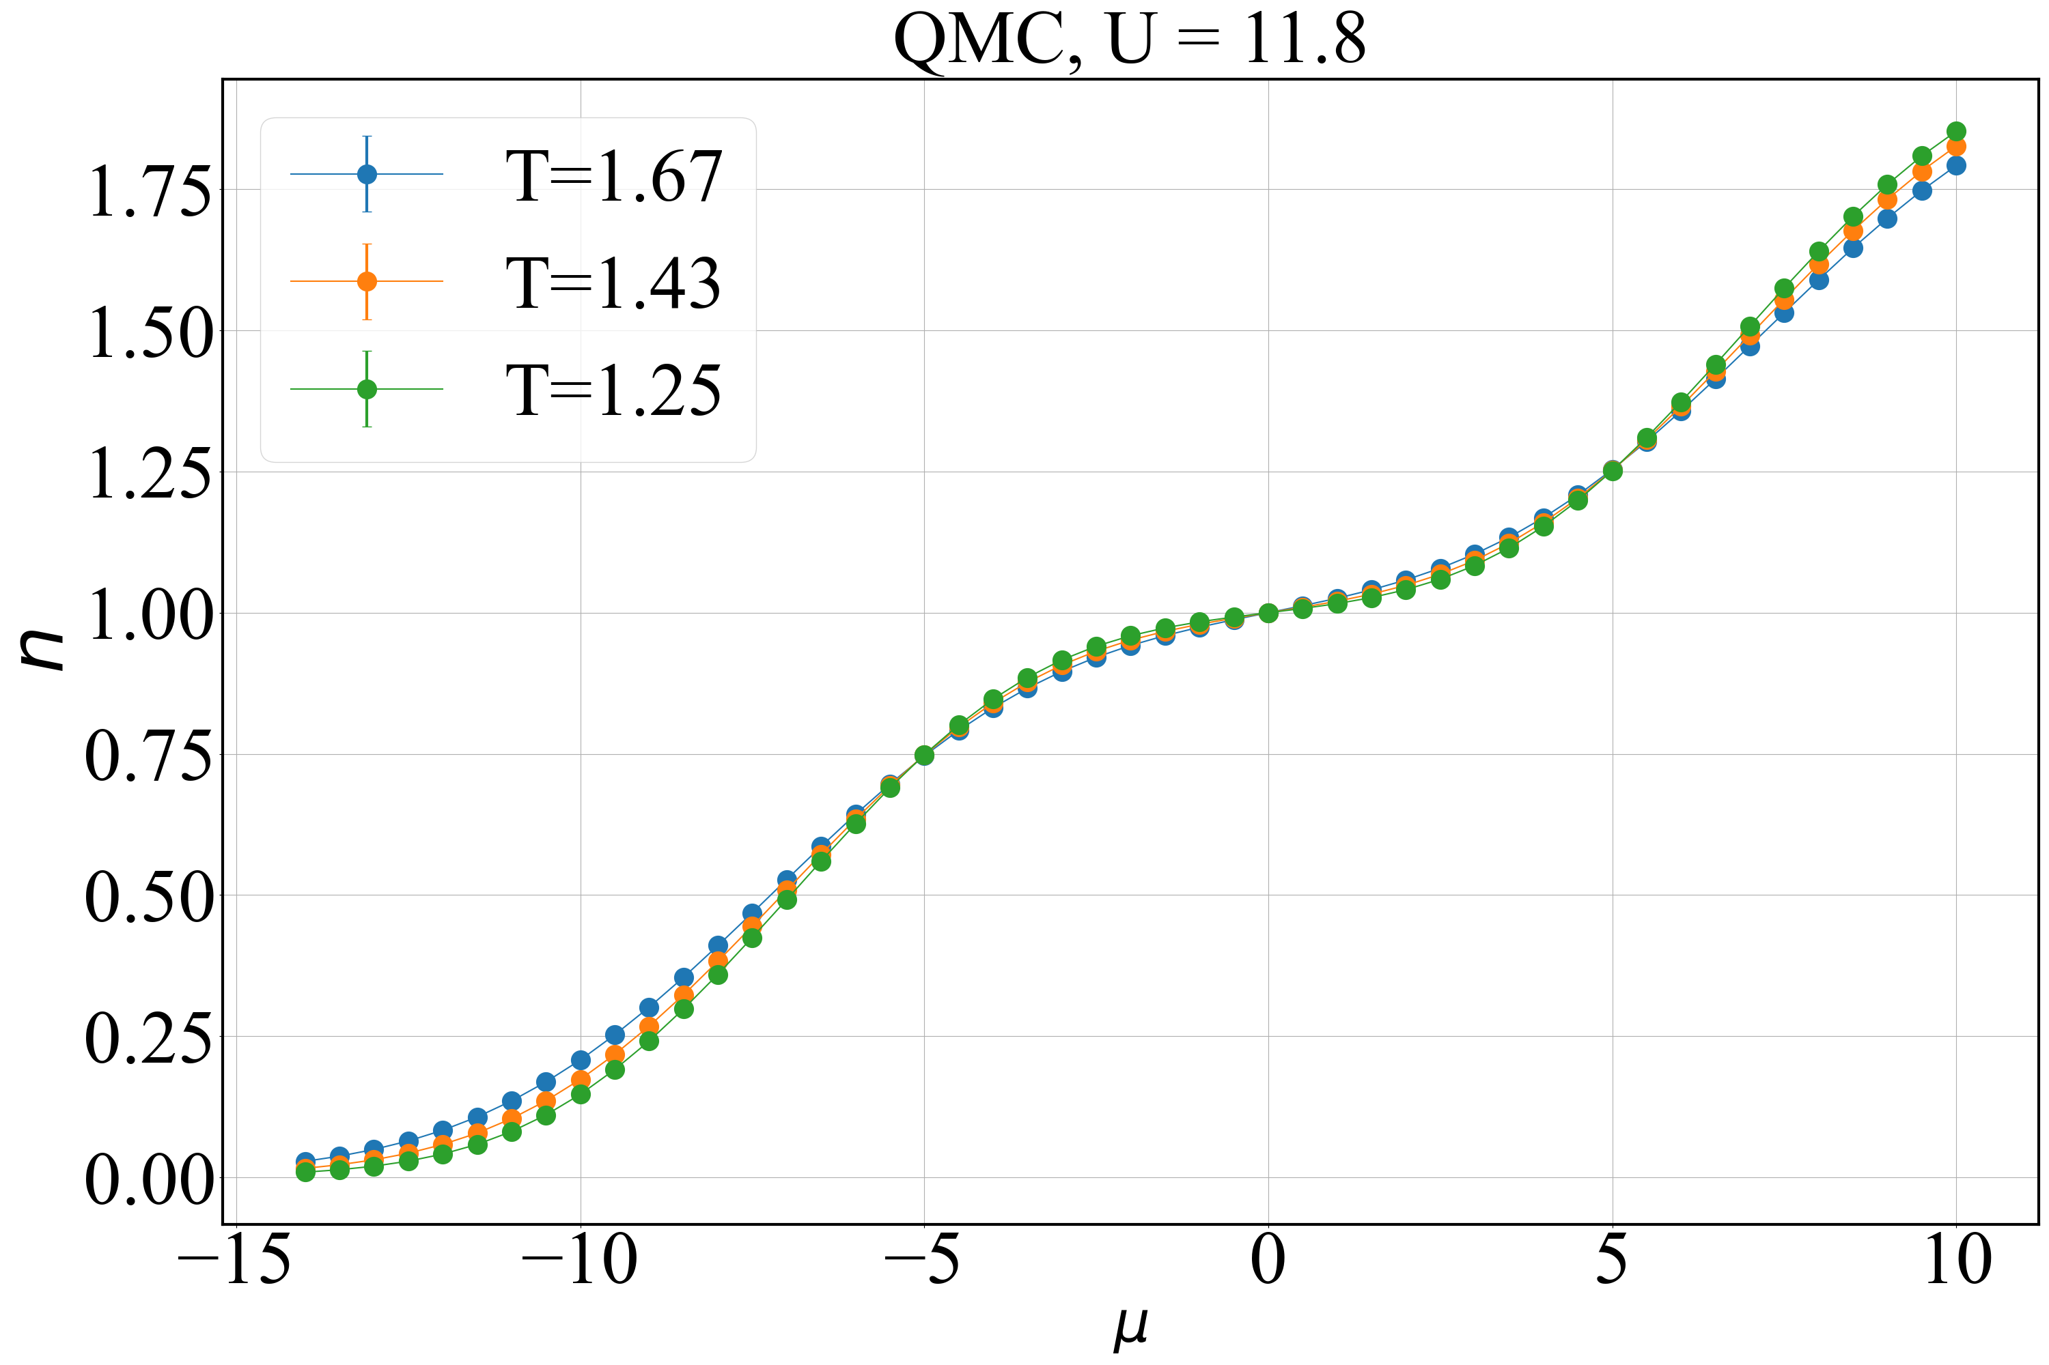
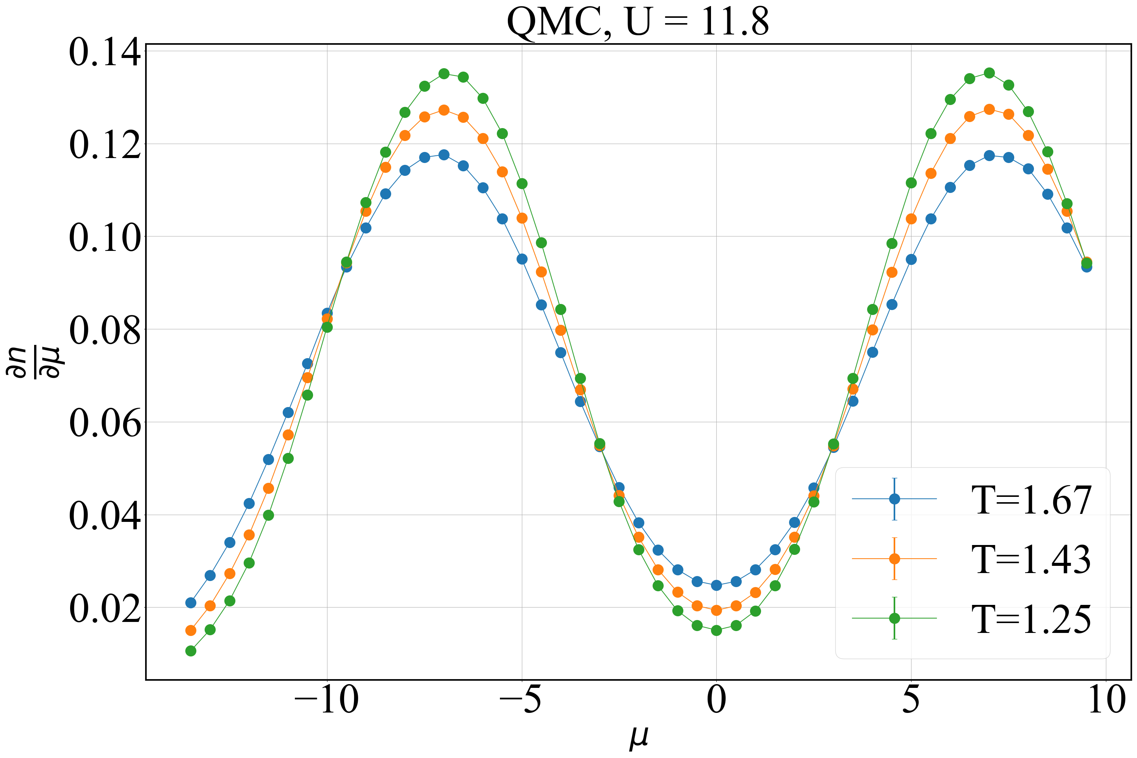
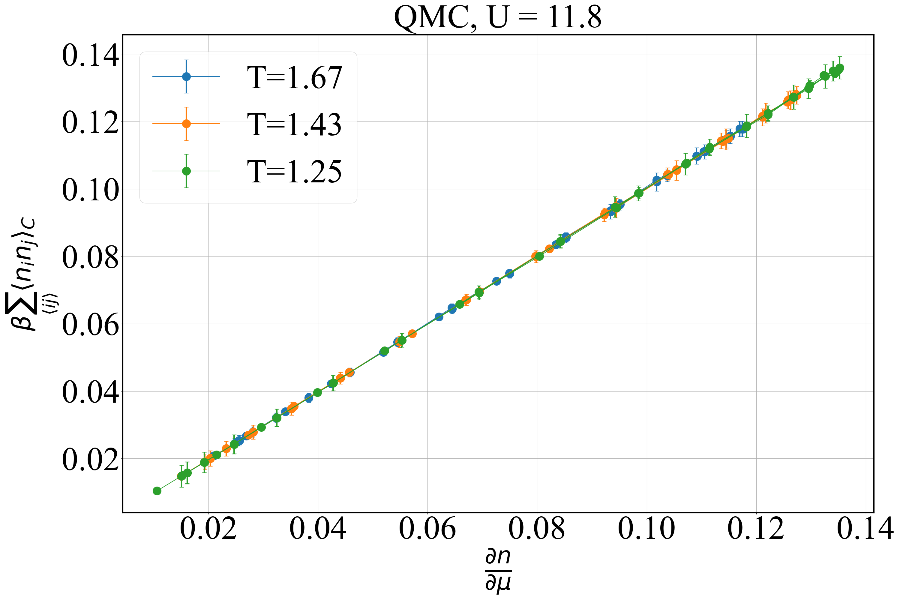
EOS and FDT from QMC
FDT implies density correlations are consistent with thermodynamics in QMC

Slide 6
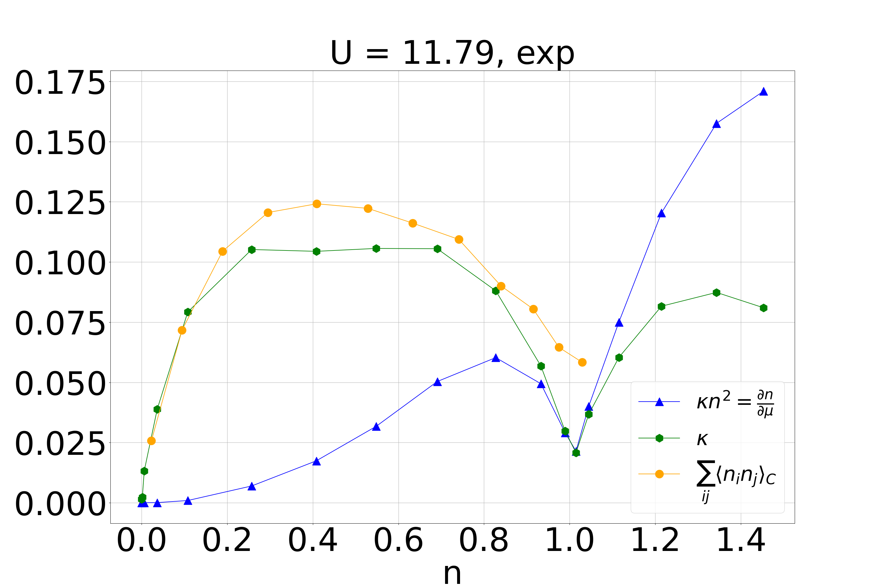
EOS and FDT from experiment at U = 11.8

